Slide 1

Managed Entry Agreements (MEAs)
-Opportunities & Challenges for African Countries-
Hector E. Castro MD, PhD
Senior Technical Director
Photo credit: Rui Pires

Slide 2
ABOUT MSH
Management Sciences for Health (MSH) builds strong health systems that deliver everything it take to prevent disease, treat illness, and empower people to lead healthier lives. For more than 45 years in over 150 countries, MSH has worked shoulder to shoulder with our partners to build stronger health systems for better outcomes and performance. Our work will not be done until all people in need have equitable access to health care.
^{MSH in 2016}
72 Countries, 41 Offices. Total Staff: 1,849. Staff Outside US: 1,477
93% of MSH personnel in countries or regional offices are from the country or region where they work.
Notes:
When adding slides to your presentation, please use our branded fonts if possible: Garamond or Gill Sans. If these fonts are problematic, please use Calibri or Arial.

Slide 3
Background
All health systems face challenge of finite resources vs. unlimited demand for services.
30 million deaths occurred in LMICs due to NCDs.
CVD, cancer, diabetes, and chronic lung diseases the 4 causes of NCD deaths.
R&D for NCDs proven to be effective and cost effective in many cases.
Uncertainty on effectiveness and cost of new, patented therapies may delay reimbursement and patient access,.
“Managed entry agreements” (MEAs)—a type of formal institutional arrangement between manufacturers and payers for sharing financial risk surrounding the introduction of new pharmaceutical technologies have emerged.

Slide 4
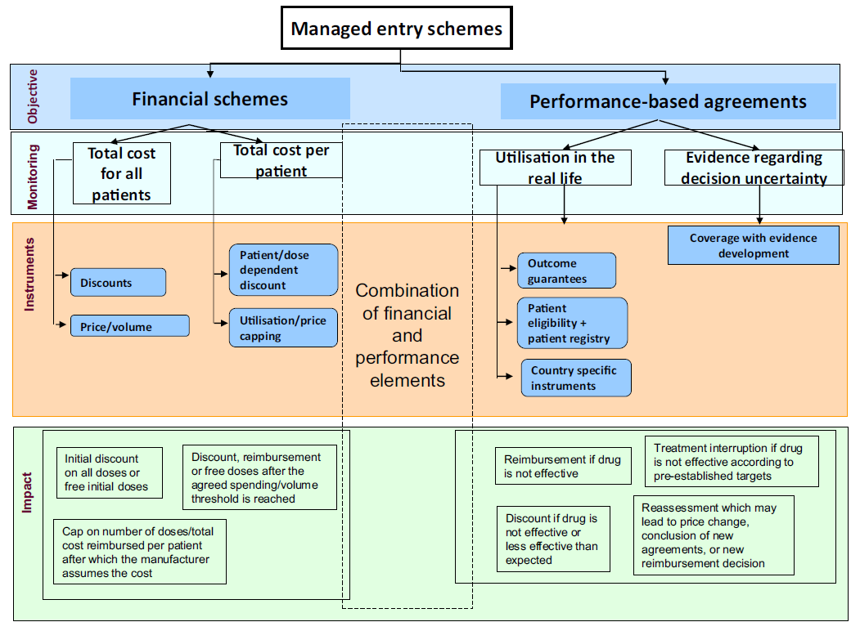
Taxonomy for MEAs
Source: Kanavos et al (2017)

Slide 5
OUR RECENT WORK
Funded by the WB; pilot stage 3 countries (Col, Ken, Ukr)
Activity I: Catalog and evaluate existing medicines access programs, including those for generic medicines.
  Systematic literature review- Dec/ 17- Feb/18
  Gray literature review- Jan- Feb/2018
  Semi-structured interviews with key informants in 3 countries (Colombia, Kenya, Ukraine)- Feb/ 18
  Triangulation with 5 global thought leaders in financial and performance based access mechanisms- Mar/18
Activity II: Co-create new evidence for smarter decision-making in the LMICs context.
Activity III: Develop a compendium of “good practices” for access strategies.
Activity IV: Support dissemination and use of results

Slide 6
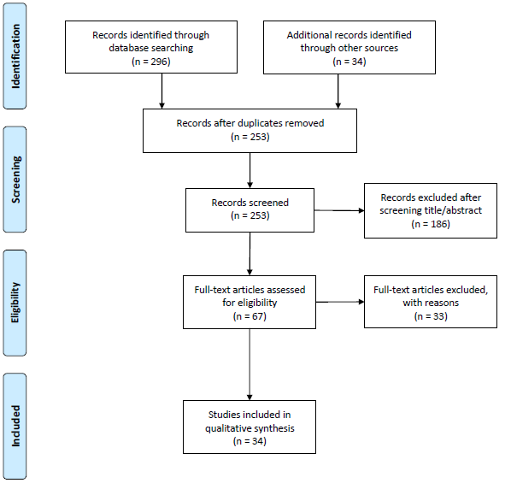
PRISMA Flow Diagram
Total = 330
Total 285 agreements
Financial schemes: 50.2% (143)
  Price/Volume (18.92%)
  Discounts (17.5%)
  Utilization/price capping (7.7%)
  Other or not specified (55.9%)
Performance-based schemes: 44.2% (128)
  Coverage with evidence development (39.1%)
  Outcome guarantees (32.8%)
  Patient eligibility + patient registry (5.5%)
  Other or not specified (22.7%)
Other: 4.9% (14)

Slide 7
Findings
285 schemes retrieved from the search. Most (68%) took place in European countries
Financial-based schemes predominant in Europe, Asia, and Oceania/Pacific regions, performance-based more frequent in North America
Specially cancer (e.g. breast cancer, chronic myelogenous leukemia, colorectal cancer)
Fewer schemes focused on communicable conditions (e.g. HIV/AIDS, cervical cancer, malaria, tuberculosis, pneumococcal disease)
Most gray lit. sources focused on licensing agreements and how to navigate TRIPS flexibilities.
The WHA meetings (2011-2017) discussed 5 main mechanisms to improve access to medicines: TRIPS flexibilities and the Doha agreement, voluntary pooled funding & procurement, sin taxes, public-private partnerships (shared risk) and grant schemes.

Slide 8
Interviews Summary
Fieldwork: Feb 2018; Bogota, Nairobi and Kiev
Participants: 31/32 interviewees attended (11 in Kenya)
Profiles: 21 men; 10 women. All experts and familiar with the local context (11m/ 1w Kenya)
Organizations: MoH, NRAs, payers, procurement agencies, pharma, patients, insurers (MoH; PPB; MEDSource; KEMSA; KENCO; KAPI; Insurers; MEDs)
CATEGORIES OF ANALYSIS:
  Challenges
  Level of awareness and ongoing initiatives
  Potential ‘drivers’

Slide 9
Common Challenges
Cost, affordability and chronicity of healthcare for NCDs********
High OOP as a means of choice*****
Sustainability and budget constraints and price discrimination in LMICs****
Competing priorities under UHC/ limited / Fragmented coverage ****
Inadequate and inflexible state budget allocation to procure innovative medicines***
Lack of standardization of health care (no CPGs, barriers to diagnosis)***
Uncertainty of real value of innovation***
Cancer (breast, lung, colon), orphan, CVD and Diabetes ***
Technological pressure (biologicals)**
Limited patient education/ awareness/ self-care **
Lack of trust in generics, falsified, substandard, counterfeit medicines*
The concept of health as a fundamental right**
Protective legislation towards IP*
Limited local manufacturing capacity
Limited PPP initiatives in place

Slide 10
CURRENT INITIATIVES
Breast Cancer and Tamoxifen, Herceptim based on discounts and subsidies (Novartis, ROCHE) *******
Healthy Hearth Africa by Astrazeneca and CVD, Cancer (screening and subsidies); Asthma GSK and DM Novo. Previous initiatives for infectious diseases ******
Experience and interest in pooled procurement and discounts and price/volume agreements KEMSA, MEDs, MEDSource, retailers ******
Systems strengthening, supply chain and centralized quantification SIAPS, MSH ***
Advocacy and patient awareness raising and patient supported groups ***
TRIPS flexibilities awareness envisioned as options by GoK (DPI, CL, parallel imports) **
Small scale initiatives in place**
NHIF new allocation of specific budget for NCDs **
Expedited pathways for registration and NRA harmonization
Generic substitution

Slide 11
The Emergence of ‘Drivers” for MEAs
CATEGORIES
Capacity: regulatory, availability and quality of data, patient registry, ability to M&E outcomes, availability of local clinical practice guidelines (CPGs), health technology assessments (HTA) or priority setting in place, centralized or pooled procurement, level of awareness on MEAs
Clear rules: legislation, roles and responsibilities, sources of funding, SOPs, roadmap for implementation, timelines, enforceability, pre-established goals and outcomes, price adjusting rules
Political: policy agenda, political will, support from payers, manufacturers or government, coalitions and networks, financial support, policy champions
Local context: level of income, market size, ability to aggregate or negotiate, political stability, fragmentation, previous local successes, international cooperation, coordination
Perception: usefulness perception, perception of complexity, market attractiveness from both sides (payers & developers), successful experiences from other similar countries, perception of limitations on MEAs

Slide 12
The Emergence of ‘Drivers” for MEAs
CATEGORIES
Cultural: resistance to change, corruption, culture of transparency, lack of trust among key stakeholders, attitudes towards big pharma, attitudes towards the public and private sector
Evidence: sufficiency and quality of evidence, real world evidence, evidence on cost-effectiveness, on patient eligibility
Risk bearing: risk attitudes from payers or manufacturers, assurance that heavy losses would be compensated, compliance with agreement, potential risk of affecting international or portfolio revenues, risk attitudes towards uncertainty
Uncertainty: uncertainty of real (efficacy/ effectiveness), safety, value of innovation, other structural factors that may influence outcomes, eligibility, long term impact (outcomes and financial)
Transparency requirements: issues about transparency of pricing or confidential agreements, competition, publicly released information, information on rebates and discounts

Slide 13
Key messages 1
It seems the interest in MEAs has increased in recent years according to the number of peer reviewed publications
Most publications on MEAs report the experience of HICs, being Europe the most prominent setting (23 countries).
Financial-based schemes were slightly more frequent than performance based mechanisms.
Performance-based schemes more predominant in North America.
Majority of schemes in HICs covered treatments for non-communicable diseases, predominantly different types of cancer.
An important number of international NGOs and global advocacy groups are raising awareness on TRIPs flexibilities to promote access to on patent medicines for NCDs.

Slide 14
Key messages 1I
The level of involvement from international organizations and donors seems limited in the case of MEAs.
Comprehensive approaches used in the past for ID and NIDs may serve as benchmarks for NCDs.
The level of awareness and experience on MEAs in LMICs seems very limited, therefore an opportunity to provide TA.
Overall, geographical reach of medicines access programs initiated by pharmaceutical companies is quasi global, important to consider market driven approaches (PPP).
The emergence of ‘drivers’ for implementing MEAs may help to design an international roadmap for policy action.
Modelling P, V and uncertainty of clinical outcomes may help to bridge the gap among payers and manufacturers, but also to set up a pathway for HS strengthening.

Slide 15
Photo credits, l to r: , Amy Niebling, Warren Zelman, Carmen Urdaneta

Slide 16
BRIDGING GAPS THROUGH MODELLING
Co-create new evidence for smarter decision making in the LMIC context
A consortium led by MSH and supported by RTI developing web-based, interactive decision analysis tools that allow decision makers compare policy scenarios in terms of their ability to provide affordable access to patented medicines.
Three models:
  A snapshot model of potential policy options
  A dynamic ‘bridge’ to illustrate progression
  A quantitative model to estimate price, volume and other issues

Slide 17
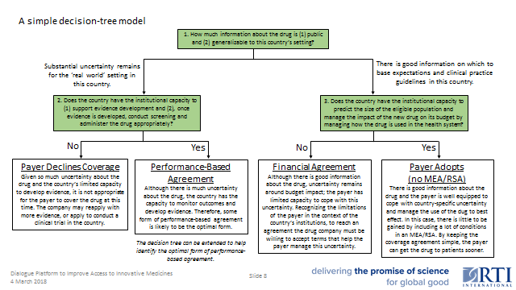
  A snapshot model of potential policy options

Slide 18
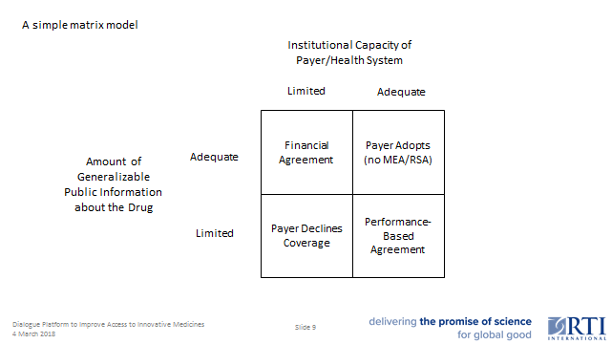
  A snapshot model of potential policy options

Slide 19
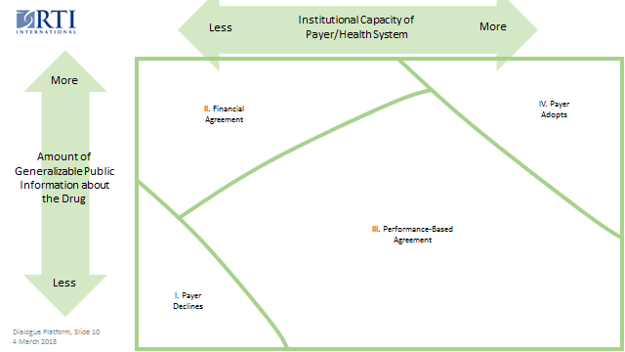
  A dynamic ‘bridge’ to illustrate progression

Slide 20
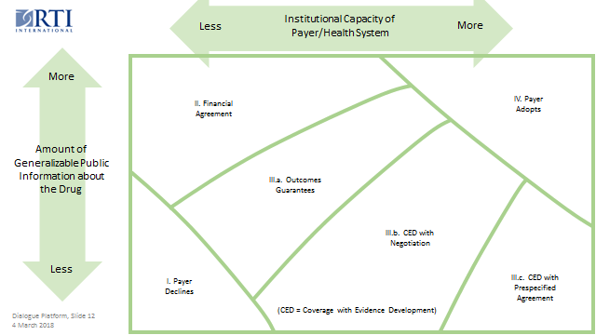
  A dynamic ‘bridge’ to illustrate progression

Slide 21
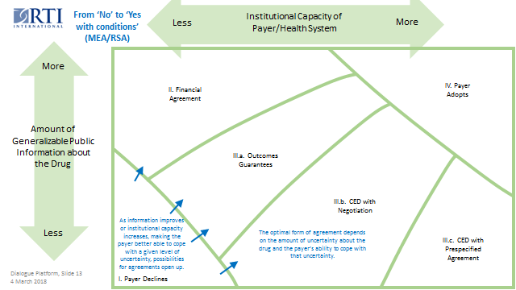
  A dynamic ‘bridge’ to illustrate progression

Slide 22
  A quantitative model to estimate price, volume and other issues
 | Key: | Input | Edit only orange cells. Click on other cells to view formulas, then 'Esc' out.
A. Payer Budget — Baseline
 | 1. Total budget for high-cost prescription drugs (HCPD):
 |  | 4,452,000 | USD | per year |  |  |  | —implies average cost per patient of
 | 2. Total number of patients receiving these drugs: |  |  |  |  |  |  |  | 285 | USD | per year
 |  | 15,644 | patients
B. New Drug Impact — Payer Adopts
 | 1. Treatable patient population:
 | → | 10,000 | patients who could benefit
 | 2. Proposed number of patients to treat: |  |  |  |  |  |  | —implies the following outcomes:
 |  | 2,000 | patients who will receive treatment |  |  |  |  |  | Buget Impact: | 1,750,000 | USD | per year
 | 3. Treatment expansion: |  |  |  |  |  |  |  | ( | 39% | increase)
 |  | Of the patients to be treated, how many are not already receiving HCPD? |  |  |  |  |  |  | New average cost per HCPD patient per year:
 |  | 650 | new HCPD patients |  |  |  |  |  |  | 381 | USD | per year
 | 4. Treatment replacement: |  |  |  |  |  |  |  | ( | 34% | increase)
 |  | For those patients who are already receiving HCPD, what is the average cost per patient of drugs this new one will replace? |  |  |  |  |  |  | Based on the following treatment assumptions:
 |  | 0 | USD | per year |  |  |  |  |  | 2,000 | patients treated with new drug
 | 5. Price of new drug per patient treated: |  |  |  |  |  |  |  | Of these, . . . |  | 1,350 | were already receiving HCPD
 |  | 875 | USD | per year |  |  |  |  |  |  | 650 | were not already receiving HCPD
 |  | NOTE: If treatment duration is less than one year, this is simply the price for treating one patient.

Slide 23
  A quantitative model to estimate price, volume and other issues
C. New Drug Impact — Financial Agreement
 | Still assuming:
 |  | 10,000 | patients could benefit, and
 |  | 2,000 | patients will receive treatment
 |  | at an average price per patient of
 |  | 875 | USD | per year |  |  |  | —implies the following outcomes:
 | 1. Effectively reduced price for additional patients: |  |  |  |  |  |  |  | Buget Impact: | 1,775,000 | USD | per year
 |  | 25 | USD | per year |  |  |  |  | ( | 40% | increase)
 |  | (to be achieved by caps, rebates, or other means) |  |  |  |  |  |  | New average cost per HCPD patient per year:
 | 2. Number of additional patients treated at reduced price: |  |  |  |  |  |  |  |  | 371 | USD | per year
 |  | 1,000 | patients treated at reduced price |  |  |  |  |  | ( | 30% | increase)
 | 3. Treatment expansion: |  |  |  |  |  |  |  | Based on the following treatment assumptions:
 |  | Of these additional patients, how many are not already receiving HCPD? |  |  |  |  |  |  |  | 3,000 | total patients treated with new drug
 |  | 500 | new HCPD patients |  |  |  |  |  | Of these, . . . |  | 1,850 | were already receiving HCPD
 | 4. Treatment replacement: not applicable |  |  |  |  |  |  |  |  |  | 1,150 | were not already receiving HCPD
 |  | Assumption: New treatment at reduced cost will not be used to replace other HCPD usage; patients for whom the new treatment will replace HCPD will be covered at the negotiated price; coverage at the reduced price will be restricted to patients not already receiving HCPD for this condition.

Slide 24
  A quantitative model to estimate price, volume and other issues
D. New Drug Impact — Performance-Base Agreement
 | NOTE: In this version, modeling is limited to Outcomes Guarantees. In future versions, the modeling can be extended to Coverage with Evidence Development.
 | 1. Percentage of treated patients expected to respond: |  |  |  |  |  |  | —implies the following outcomes:
 |  | 55% | expected positive response rate |  |  |  |  |  | Buget Impact: | 1,443,750 | USD | per year
 | 2. Average health impact per responding patient |  |  |  |  |  |  |  | ( | 32% | increase)
 |  | 0.85 | DALY | per year | of treatment |  |  |  | New average cost per HCPD patient per year:
 |  |  |  |  |  |  |  |  |  | 351 | USD | per year
 | Assumptions: |  |  |  |  |  |  |  | ( | 23% | increase)
 | Rebates will given for any non-responding patients. Rebates will be given at the reduced price as long as the total number of responding patients is greater than the number paying the negotiated price. If the number of responding patients falls short of the number paying the negotiated price, the difference between the number responding and the number paying the negotiated price will be rebated at the negotiated price. |  |  |  |  |  |  |  | Expected cost effectiveness:
 |  |  |  |  |  |  |  |  |  | 1,029 | USD | per | DALY

