Slide 1
Role of epidemiological modelling to support decisions in public health” iDSI HTA workshop
21st Feb 2017
Klim McPherson
Laura Webber
Martin Brown
Oxford University and
UK Healthforum

Slide 2
Outline of talk
Predicting Exposures
Methods of predicting health
Role of micro simulation
Problems of micro simulation
UKHF (Govt) work
Examples

Slide 3

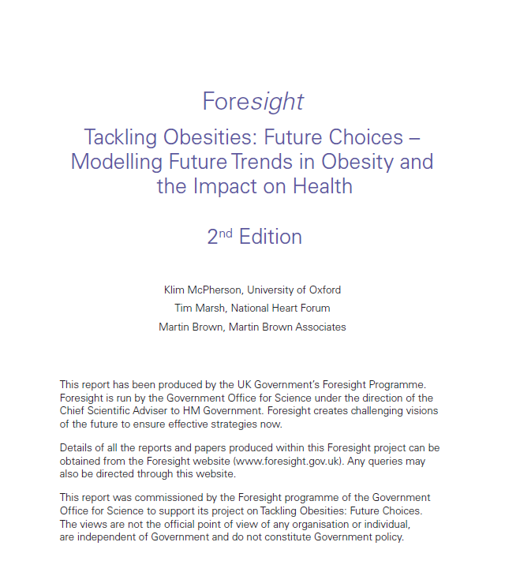
Foresight: Tackling Obesities

Slide 4
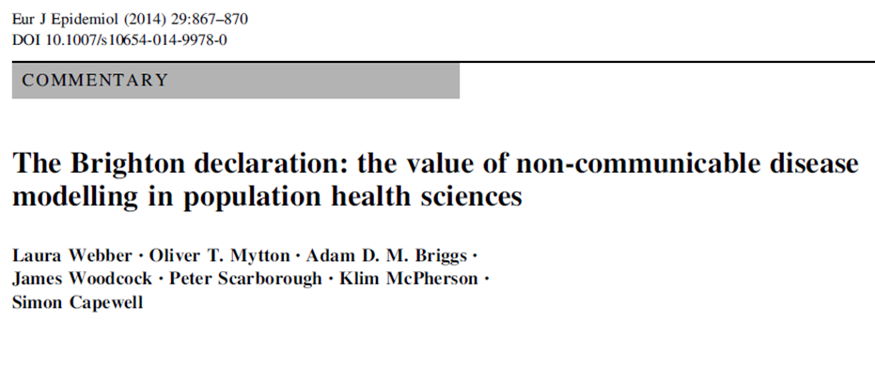
The value of NCD modelling
87% deaths due to NCDs
in Europe
How will the burden change over time?
What are the effects of policy interventions?
Modelling is key for resource planning, surveillance, responding to the NCD epidemic
Notes:
87% deaths are due to NCDs – most developing countries seeing a shift in disease burden from communicable to NCDs, this is expected to grow
Need to understand the epidemic better – how the burden will change over time, based on current trends (demographic, risk factors, disease incidence etc), and what are the effects of interventions? In terms of disease incidence and costs avoided?

Slide 5
Methods invoke: Two Modules:
1. Take current and past prevalence of exposure to risk factors from National surveys and project forward to 2050 (say), by age, sex, ethnicity, class, region etc
2. Follow (micro) simulated population (true to contemporary demographics) applying known epidemiology for predicted risk factor exposure and record disease incidence (by stage), prevalence, costs, mortality, QoL etc. Therefore life expectancy

Slide 6
Health outcomes micro simulation
input data
risk_distribution.exe
C⁺⁺ development 2006-2014
Risk distribution data
input data
health_outcomes.exe
C⁺⁺ development 2006-2014
Health outcomes

Slide 7
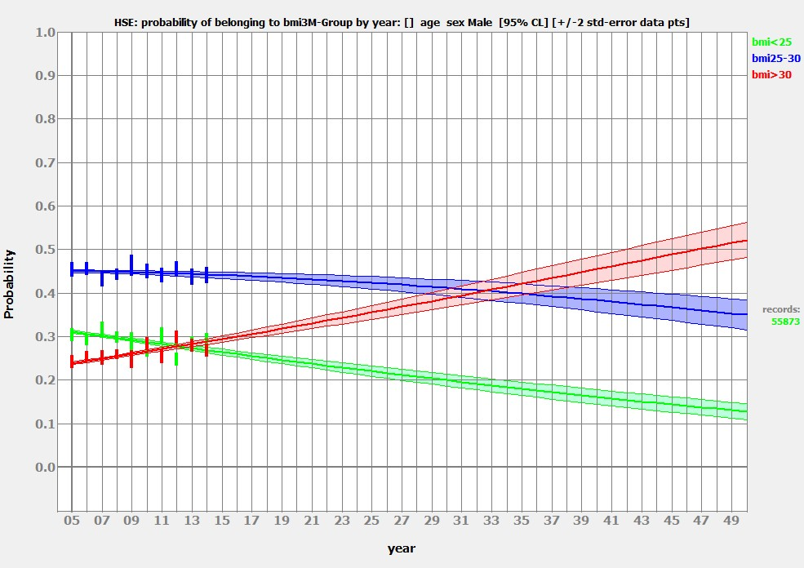
Results – Module 1
18-100 yrs, males (HSE 2000-2014)
~52%

Slide 8
Risks markedly increase within "normal" BMI range
Aged 30-55 at start
"Normal" BMIs
Adapted from Willett, Dietz & Colditz, NEJM, 1999; 341, 426-434

Slide 9
Other risk factors…

Slide 10
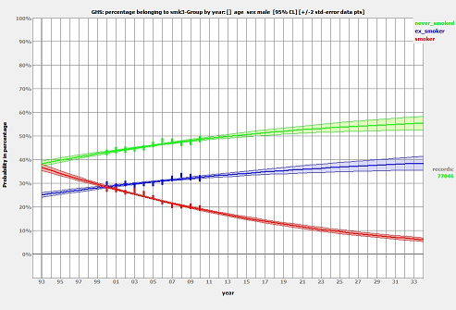
Smoking consumption – UK males
~7%

Slide 11
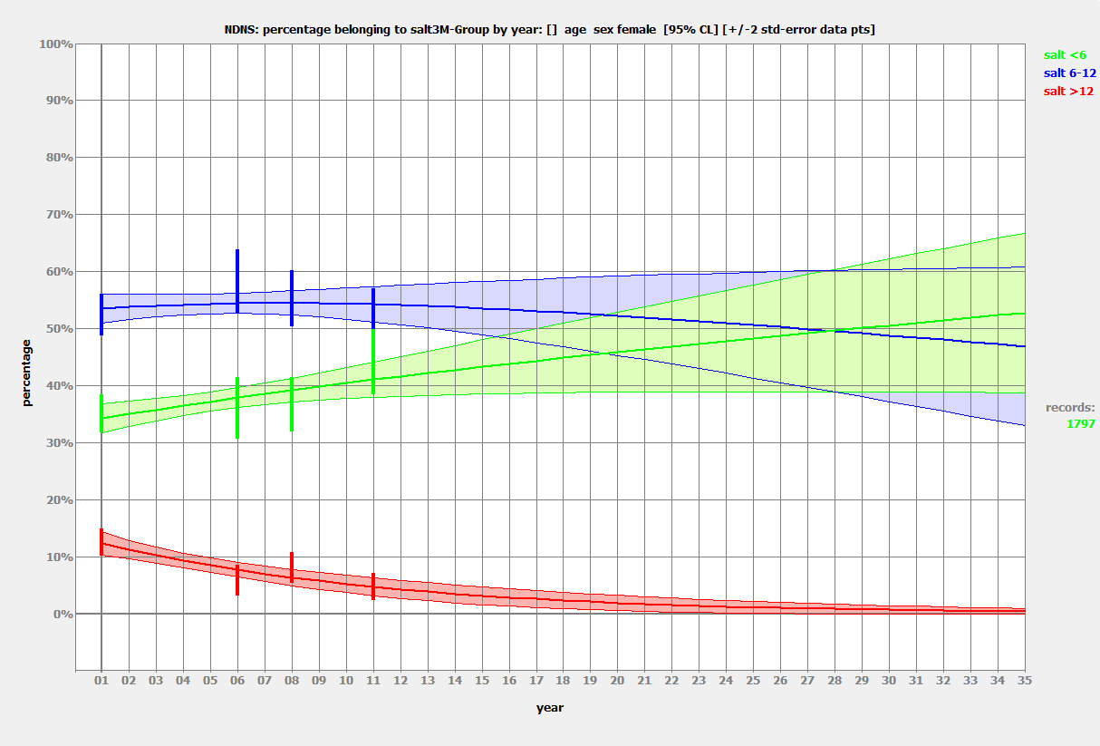
Salt consumption – females 18-100yrs

Slide 12
Module 2: Micro-Simulation
Computer model of any specified population
Population accurately reflects age, social profiles, birth, death and health statistics to make future projections
Model specifically targets the relationship between individuals’ evolving risk factors and disease incidence (several million individuals)
Risk factor distributions are determined by predictions & specified health interventions
The model can simulate and compare the impact and cost of various public health interventions
Simulations for over 80 countries and 50 US States at present
Notes:
The microsimulation is a type of simulation modelling that generates individual life histories

Slide 13
Micro Simulation, 2014-2030 say
Disease incidence
Pevalence
NHS costs
Social Cost
QoL
Life expectancy
etc
Epidemiology decides risk for individuals.
>60 million say
Population
demography.
Changing risk
factor exposure
PH Policy changes risk factor exposure
England & Wales population,
Or Oxford County Council
Or any LA
Plus survey data
Steady state
Delta
New Policy

Slide 14









Modelling & simulation map
Risk data
RISK PROJECTIONS
Disease data
Health economic data
Population data
Intervention scenarios
Distribution programme
UKHF Microsimulation© programme
Input datasets
Output data
Software programmes
Output datasets

Slide 15
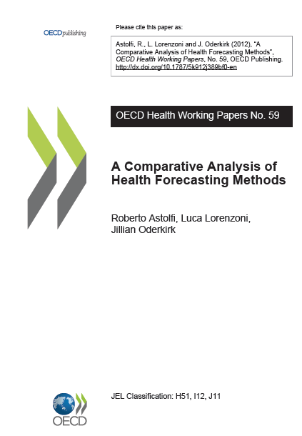
The OECD overview on modelling
“The NHF microsimulation model projects public health expenditures associated with leading diseases where obesity is a significant risk factor. The model simulates and evaluates how future trends may change in response to policies to reduce the prevalence of obesity...
…New work has extended the model to focus on smoking and smoking-related diseases and the model is extensible to a broader range of risk factors and diseases.”
Notes:
Comparison of our work can be found in the OECD report comparative analysis of health ….

Slide 16



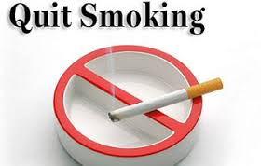

Interventions
Policy interventions
Hypothetical e.g. 1% or 5% reduction in BMI
Prevention, screening and treatment
TAX

Slide 17
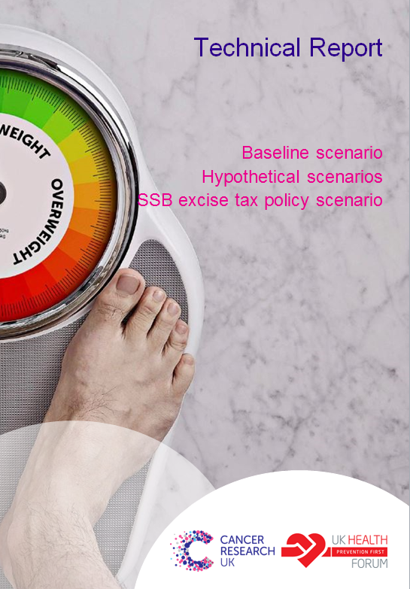
Sugar
Sweetened
Beverages

Slide 18
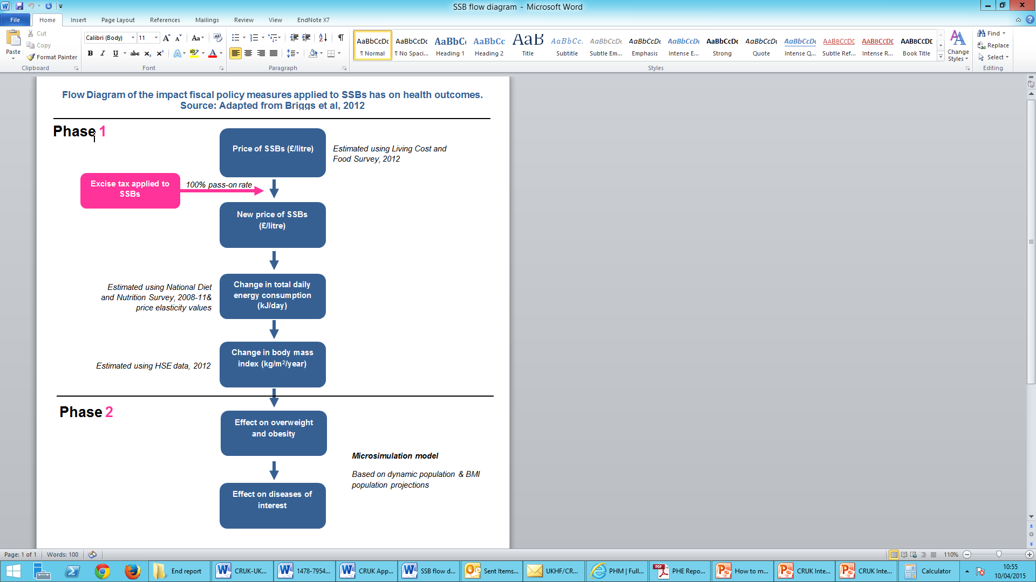
Modelling SSB tax
Flow diagram

Slide 19
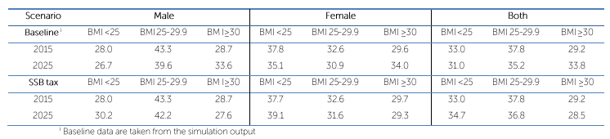
Modelling SSB tax
This 5% shift (from 34% to 29%) would be responsible for a reduction of
3.7 million obese people by 2025

Slide 20
Modelling SSB tax
An SSB is predicted to result in the avoidance of 25,498 new cases of BMI-related diseases by 2025
CHD
4,697
8 Cancers
671
Type 2 diabetes
18,117
Stroke
2,013
£3m/yr
£5m/yr
£1m/yr
£1m/yr

Slide 21

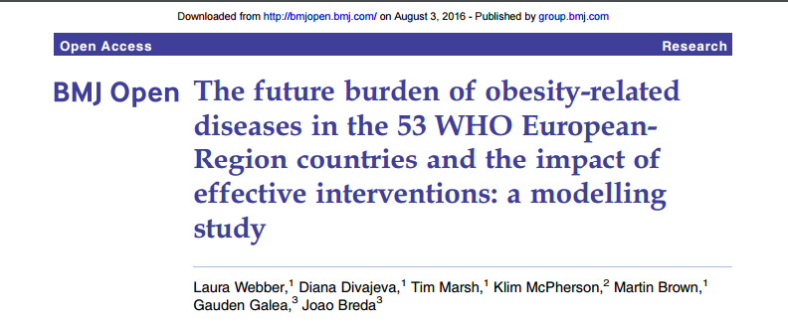

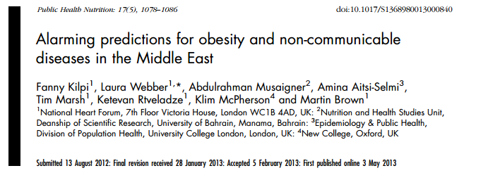

What-if scenarios

Slide 22
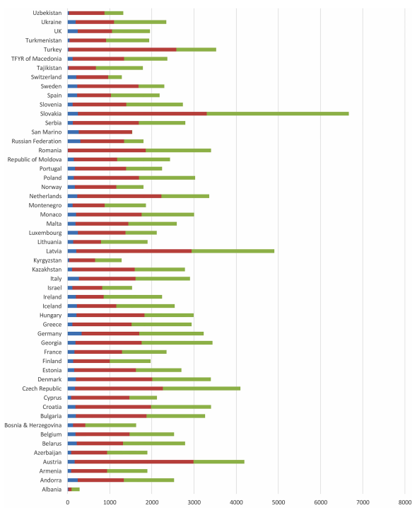
What if scenarios – Europe
Cumulative incidence cases avoided by 2030, per 100,000
5% reduction in BMI
Cancer
CVD
Diabetes
Webber et al, 2014 BMJ Open
Notes:
Huge range across countries of prevalence of each disease

Slide 23
What if scenarios
Prevalence cases per 100,000 by scenario for the Netherlands in 2030
149
542

Slide 24
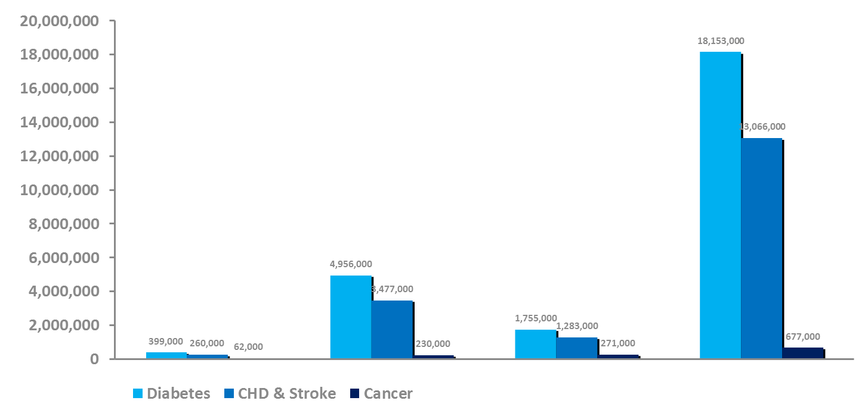
What-if Scenarios – Health Care Costs
Scenario 1:
1% Reduction in BMI for
Every Adult at Baseline: Cases
Scenario 2:
Reducing Percent Obese to 5%
in Youths and 15% in Adults by 2020
UK
US
UK
US
2000
$1.93 Trillion
1800
1600
1400
1200
1000
In millions
800
$686 Billion
600
400
£61.8 Billion
£15.5 Billion
200
0
Health and economic burden of the projected obesity trends in the USA and the UK; YC Wang, K McPherson , T Marsh, SL Gortmaker, M Brown. The Lancet 2011: 378, 9793, 815-825 )
Number in red represents medical costs avoided

Slide 25
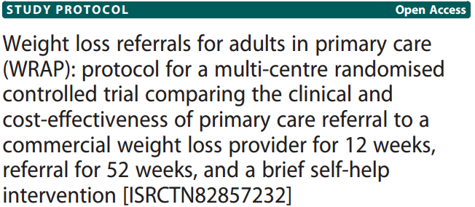
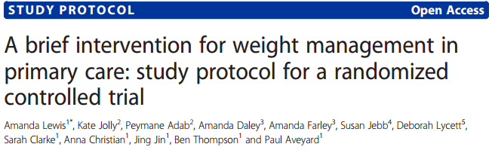
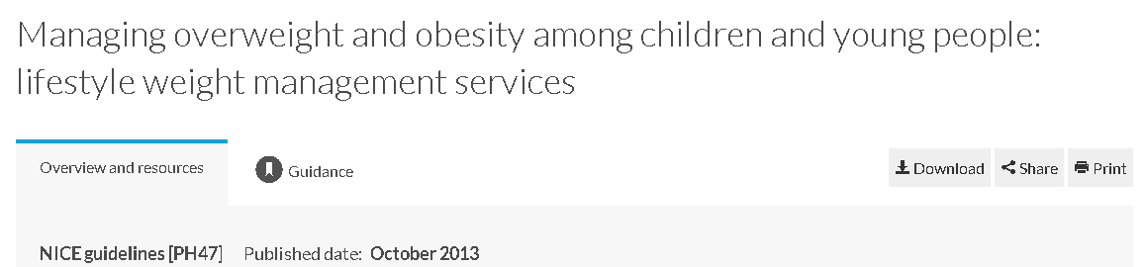
Cost-Effectiveness modelling

Slide 26
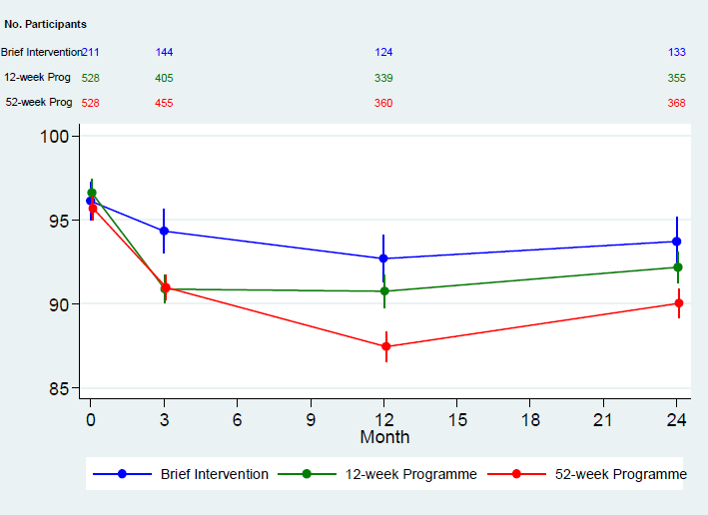
Mean weight change over time, three interventions
Extended and standard duration weight loss referrals for adults in primary care (WRAP): a pragmatic randomised controlled trial. Lancet in press
Amy L Ahern PhD^{1,2*}, Graham M Wheeler PhD^{3,4}, Prof Paul Aveyard PhD⁵, Emma J Boyland PhD⁶, Prof Jason CG Halford PhD⁶, Adrian P Mander PhD³, Jennifer Woolston BSc¹, Ann M Thomson MSc¹, Melina Tsiountsioura MSc¹, Darren Cole¹, Bethan R Mead MSc⁶, Lisa Irvine MSc⁷, David Turner MSc⁷, Prof Marc Suhrcke^{7,8}, Laura Pimpin PhD ⁹, Lise Retat PhD ⁹, Abbygail Jaccard PhD ⁹, Laura Webber PhD⁹, Simon R Cohn PhD¹⁰, Prof Susan A Jebb PhD^{1,5}

Slide 27
Using micro simulation predicting next 25 years, till 2039. Assuming linear return to original weight for five years and then follow national trends (worst case ?)
52 weeks @ Weightwatchers v 12 weeks
- 1786 fewer disease cases per 100,000
+ 1282 QALYS per 100,000
+ £4.9 million per 100,000 (costs - benefits)
+ £3804 ICER (cost diff/QALY diff)

Slide 28
Cost-effectiveness of interventions
Cost of intervention
Cost of disease by stage
Discount rate
Prevention \ screening
management
treatment
Risk factor
Stage 1
Stage …
Stage N
CVD \Death
Outputs: prevalence, incidence, QALY, DALY, total health care cost, indirect cost, ICER
Proxy data (NL, UK) general cost-of-illness study, as the RIVM has performed for The Netherlands since 2003
Notes:
The economic module is envisioned as a shell around the epidemiological model. For each patient that is counted in a disease stage in a certain cycle, costs and health outcomes are counted. Costs can include intervention costs, health care costs and productivity losses; health outcomes can include life years and quality of life. The model is built so, that all these elements can be included, or set to 0 if necessary. These choices will be country, or jurisdiction, specific.
All parameters that are used will be set locally. This includes discounting rates, which are different for many of the countries in Europe.
Unfortunately, we have encountered a severe shortage of available data in most countries. This is more of a problem than it was for the epidemiological model. As a starting point, we have collected data for The Netherlands and the UK, which are the most data-rich countries for cost-effectiveness. Using consumer price indices and purchasing power parities, these have been converted to the local price level, as best as possible. These filled in sheets are then sent to local health-economists, who are looking for better data sources.
The use of data from other countries, can be used as an incentive to local decision makers, to start investing in local data. A good starting point for many of the European countries will be a general cost-of-illness study, as the RIVm has performed for The Netherlands since 2003.
Time!!!"

Slide 29
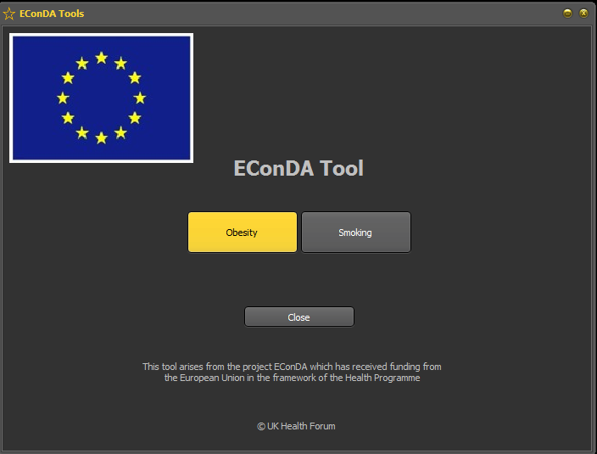

Tools www.econdaproject.eu/tools.php
EHA

Slide 30


Slide 31
Multiple interacting risks and diseases
BMI
Type 2 diabetes (glucose)
Stage 0 →1→2
Alcohol
MI
( CHD )
Kidney disease (eGFR/albumin)
Stage 0 →1→2→3
Cholesterol
Salt
Hypertension (bp)
Stage 0->1→2
Stroke
Physical Activity
COPD (FEV)
Stage 0→1→2->3→4
Smoking
Notes:
Multi risk Diseases – for example MI and Stroke
The diseases may be multi-stage (minimum 2 stages); stage 0 is the no-disease state, ….
The stages are classified by the level of the dependent risk factor or risk factors.
Stages may change as a function of age.
Stages are affected by the BMI and Smoking risk factors as shown.
How to Model MI?
BMI and Smoking (alone) may be independent but the set of MI risks are definitely NOT independent:
MI=MI(BMI, Smk, Hyt(BMI, Smk), T2D(BMI), Kid(BMI), COPD(Smk))
Same is true of Stroke
MI, CHD, CVD and stroke are shown as single stage diseases but not necessary
eGFR = estimated Glomerular Filtration Rate
FVC Forced vital capacity
FEV_{t} Forced expiratory volume (time): the volume of air exhaled under forced conditions in the first t seconds
FEV₁ =FEV_{t=1}
COPD stages are by FEV/FVC ratio (some disagreement amongst medics)
Diabetes stages are contentious (are half the Chinese nation pre-diabetic?)

Slide 32
Updates and future progress
-Multiple independent risks are almost implemented, copulas are conceptualised but not yet implemented
-World bank – Modelling the health impact of tobacco taxation in lower middle income countries, and possibly SSBs in the middle east
- PHE – air pollution – Developing a tool for use by local authorities to test the long term health and cost impacts of air pollution
- PHE – health inequalities – Microsimulation for use by local authorities to test the long term health and cost impacts of health inequalities (dependent on data available).
- CRUK – we are modelling the health impacts of halting downward trends in smoking prevalence
- JANPA – the joint action on nutrition and physical activity – we are modelling the lifetime costs of childhood obesity in 8 EU countries

Slide 33
Developments: Copulas
Copulas are a common mathematical tool which can be used to estimate the dependence between two or more random variables.
They are useful in cases where the joint distribution of one or more random variables is unknown.
They allow easy separation of information about the co-dependence of each correlated risk factor or diseases and their overlap between variables.
JOINT DISTRIBUTION
OBESE
T2DM
CHD

Slide 34
Copulas
In probability theory and statistics, a copula is a multivariate probability distribution for which the marginal probability distribution of each variable is uniform. Copulas are used to describe the dependence between random variables.
Their name comes from the Latin for "link" or "tie", similar but unrelated to grammatical copulas in linguistics. Copulas have been used widely in quantitative finance to mode and minimize tail risk[1] and portfolio optimization applications.[2]
Copulas are popular in high-dimensional statistical applications as they allow
one to easily model and estimate the distribution of random vectors by estimating marginals and copulae separately. There are many parametric copula families available, which usually have parameters that control the strength of dependence.

Slide 35
Sensitivity analysis
Currently developing a sensitivity analysis module in collaboration with Dr Zaid Chalabi (LSHTM)
Previous studies have used Monte Carlo methods to estimate uncertainty.
These methods are computational expensive and involve running a large number of simulations.
Global sensitivity analysis will be used to estimate the total uncertainty from the uncertainty of each variable within a single simulation.

Slide 36
Models now and the future
  Obesity (over 80 countries)
  Childhood obesity
  Tobacco
  Physical Activity
  Alcohol
  Salt
  Cholesterol
  Diet
  Combined risk factors
  CVD
  Respiratory disease (COPD) (MS)
  Type 2 Diabetes (MS)
  Kidney Disease (MS)
  Dementia
  HIV
  Cancers
  Integrated interventions
  Health App
  Tools for GPs

Slide 37
PHE’s air pollution requirements
Develop a modelling framework focussed on air pollution which has the ability to:
quantify the potential costs to the NHS and social care due to the health impacts of air pollution at a national and local level.
assess air pollution alongside other public health risks/threats, such as physical inactivity, traffic injuries, and noise to support the strategic priority setting process and case for action.
test health benefits and cost reduction both for the NHS and social care under different air pollution scenarios e.g. meeting national air quality standards.
Notes:
1. NHS costs including GP, hospital admission, and medication use
4. including, where feasible, the outputs from the “Quantification of the health impacts from travel and transport air pollution for activities related to the health and care sector” project from the Sustainable Development Unit (due to be released in January 2017) within the modelling framework.
Additional outputs that can build on the core project
1. Inclusion of indoor air pollution as a risk factor.
2. Exploring health care costs from air pollution associated with physical inactivity, traffic injuries (if a focus on traffic-related pollution is modelled), and noise.
3. Improving and updating the model and outputs when new/better data sets become available.

Slide 38
What we will deliver
The key deliverables of this project will be:
A modelling framework to quantify the annual future costs to the NHS and social care due to air pollution related morbidity and mortality at a national and local level, now and into the future (2020+)
Provision of a downloadable tool for use by local authorities
A final report
Notes:
Further develop the collaboration between UKHF and Imperial for future more in-depth work.

Slide 39



The team’s expertise and ability to deliver
Epidemiological and health economic modelling
Health Economics
Public Health, data science and networks
Air pollution exposure
assessment
Notes:
UKHF- interdisciplinary team
Imperial MRC.. – expertise in air quality exposure w Prof. Vines, J Gulliver
IC BS … expertise in health economics, w Franco Sassi - Our expertise with these data - we have worked for decades with the HES data (NHS hospital admissions) and have put together the costs related to each admissions. I have done a lot of work to identify excess admissions due to weather variation and derived the associated costs. The other dataset would require some work (cleaned and matched together).
Joint working:
Initial joint seminar to share our work
Two weekly meetings (one tc, one face to face)
Structured timetable with set milestones
Also work closely with PHE strategy board and environmental PH prog board, COMEAP, DEFRA, NICE.

Slide 40
Past and current collaborators
World Health Organization (Global), Euro and PAHO
OECD
World Bank
DG Sanco
England: Department of Health, PHE, NICE
Governments: US, Russia, Brazil, Portugal, Netherlands, Mexico, Ireland, Namibia
Universities
UK: LSHTM, UCL, Cambridge, Oxford, Liverpool, Bristol
US: Harvard, Johns Hopkins University, Columbia, Washington, USC
Helsinki, Warsaw, Groningen, Kaunas, Moscow, Rome, Sao Paulo
European Chronic Disease Alliance

Slide 41
METHODOLOGY & APPROACH
Module 2
Strengths of the method
Best method for risk factor and chronic disease modelling (Oderkirk, 2012)
Can simulate entire populations
Takes account of individual medical history – which matters when considering NCDs
Takes account for dynamic changes in risk factor exposure over time
Offers flexibility for testing a range of ‘what if’ policy scenarios:
What may be the future health expenditures if no action is taken?
In which sector of the healthcare system are costs rising the most, or will rise?
What may happen if we put a brake on growth in public health expenditure?
What are the main drivers of rising health and social care expenditures?

Slide 42
METHODOLOGY & APPROACH
Module 2
Limitations and challenges of the method
Data intensive approach
Data availability issues
Relative risk data for certain cancers
Survival data for certain diseases
Indirect cost data e.g. sickness absence rate of certain diseases
Health-related utility weights for certain diseases
Time lags between initiation of the behavioural risk factor and contraction of disease
Notes:
For example: relative risk of disease incidence, stratified by various BMI groups and by age groups

Slide 43
The End
Klim McPherson University of Oxford klim.mcpherson@new.ox.ac.uk

