Slide 1


Role of NICE in the UK – turning evidence into policy
March 2016
Francis Ruiz, NICE International
Copyright © 2016 NICE

Slide 2
Overview
Outline of National Institute for Health and Care Excellence (NICE)
Topics:
  NICE…what is it and why was it created?
  Core principles
  Cost effectiveness and decision making
  Brief overview of Technology Appraisals
  Drug pricing and “Value Based Assessment”
  Patient Access Schemes (PAS)
  Clinical guidelines and ‘Quality Standards’
  Incentives and indicators – the QOF in primary care
  Lessons from the ‘NICE Way’

Slide 3

Why NICE was set up
Established in 1999 as the:
National Institute for Clinical Excellence (NICE)
To reduce variation in the availability and quality of treatments and care (the so called ‘postcode lottery’)
To resolve uncertainty about which medicines and treatments work best and which represent best value for money for the NHS
To encourage uptake of good value innovations
Originally a Special Health Authority and part of the NHS
Government commitment to improve the quality and range of care
Prospect of significant reinvestment in the NHS: plan to grow from about 6.5% to about 9% of GDP

Slide 4
Establishing NICE: expectations
National, authoritative source of advice
Guidance based on effectiveness and cost effectiveness
Inclusive and consultative approach
Independent and efficient
A service for the NHS and the public which uses it
Broad support from professional and user groups

Slide 5

Health and Social Care Act (2012)
“The Health Act makes NICE stronger than before”
Rt Hon. Andrew Lansley MP
Speaking at NICE Conference 2012

Slide 6

NICE is a
“Non Departmental Public Body”
No longer a Special Health Authority from 1 April 2013
Renamed “National Institute for Health and Care Excellence”
NICE enshrined in primary legislation
Greater independence from government
Remit expanded beyond the NHS to cover social care

Slide 7
NICE….what is it now ?
The National Institute for Health and Care Excellence (NICE) provides national guidance and advice to improve health and social care
We do this by:
• Producing evidence-based guidance and advice for health, public health and social care practitioners.
• Developing quality standards and performance metrics for those providing and commissioning health, public health and social care services;
• Providing a range of information services for commissioners, practitioners and managers across the spectrum of health and social care.

Slide 8
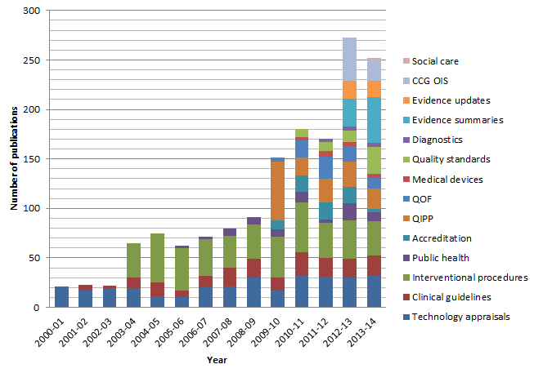
NICE: changes and evolution
560 WTE; £67.2M
~30 WTE; £11M
Notes:
This slide shows how NICE’s remit has expanded since being established in 1999 to do technology appraisals. We now produce many different types of guidance and other outputs/advice products.

Slide 9
Core principles of NICE’s work
Based on the best evidence available
Expert input
Patient and carer involvement
Independent advisory committees
Genuine consultation
Regular review
Open and transparent process
Social values and equity considerations
Notes:
Everything we do is guided by this set of underlying principles

Slide 10
Role of cost effectiveness in NICE guidance (SVJ, 2008)
“Those developing clinical guidelines, technology appraisals or public health guidance must take into account the relative costs and benefits of interventions (their ‘cost effectiveness’) when deciding whether or not to recommend them.” (Principle 2, SVJ, NICE 2008)
BUT
“Decisions about whether to recommend interventions should not be based on evidence of their relative costs and benefits alone. NICE must consider other factors when developing its guidance, including the need to distribute health resources in the fairest way within society as a whole.” (Principle 3)
See: http://www.nice.org.uk/media/C18/30/SVJ2PUBLICATION2008.pdf
Notes:
SVJ → Social Value Judgements: Principles for the Development of NICE Guidance describes the principles that NICE should follow in designing the processes it uses to develop its guidance and in developing individual pieces of guidance. It is mainly about the judgements that NICE and its advisory bodies should apply when making decisions about the effectiveness and cost effectiveness of interventions, especially where such decisions affect the allocation of NHS resources. The current edition of Social Value Judgements is the second. It was published in July 2008, replacing the first edition, which was published in 2005.

Slide 11
NICE Technology appraisals
Guidance on the use of new and existing medicines, treatments and procedures within the NHS
Two types of appraisals:
  Multiple Technology Appraisal (MTA)
  Single Technology Appraisal (STA)
  Independent academic groups carry out systematic review and develop economic model (MTA) [60 weeks]
  Critique the evidence submitted by manufacturer (STA) [30-43 weeks]
  4 Standing Committees
    Independent
    Multi-disciplinary – includes industry
  Opportunity for key stakeholders to appeal against final draft guidance
  Recommendations to be implemented within 3 months
Notes:
TA committee
-Standing Committee, working across the whole spectrum of interventions and conditions
-members drawn from Primary Care, Secondary Care, Royal Colleges, Patient Groups, Health Economists, NHS Management, Public Health, Healthcare Industries, Biostatisticians, Lay members
-one meeting per month (2-3 appraisals per meeting)
-receives all evidence, expert statements and comments 2 weeks before each meeting
-members with a conflict of interest for a particular drug cannot participate in an appraisal including that drug
Appeals:
The grounds of appeal are:
Ground one: In making the assessment that preceded the recommendation, NICE has:
a) failed to act fairly
or
b) exceeded its powers
Ground two: The recommendation is unreasonable in the light of the evidence submitted to NICE.
The Appeal panel is drawn from a group of individuals approved by the Secretary of State for Health. Each Appeal panel consists of five members. The Appeal panel is chaired by an external member who is engaged in the provision of healthcare in the NHS or someone who has experience in representing patients or carers or who is a patient or carer (patient representative). In addition to the Appeal Panel Chair, one non-executive director of NICE, one NHS representative, one representative of the life sciences industry, and one patient representative will join the Appeal Panel.
Assuming that the appeal is valid the Appeal panel will aim to hold the appeal hearing within 8 weeks of the end of the appeal period for oral hearings and 10 weeks for written submissions.

Slide 12

NICE: Assessment vs. Appraisal
Secretary of State for Health
National Institute for Health Research (NIHR)
Health Technology Assessment Programme
Commissioned
academic team
Assessment
Funding
NICE
Secretariat
Technology
Appraisal Committee
Appraisal
Topic selection
Topic referral
Topics
Technology Assessment Report
Guidance to the NHS and implementation initiatives
Adapted from Walley, T. (2007) MJA; Overview of Health technology assessment in England: assessment and appraisal187: 283–285
Notes:
The Health Technology Assessment (HTA) programme, set up in 1993, is part of the National Institute for Health Research (NIHR) and is the largest single national research programme for the NHS. It funds the production of independent research information about the effectiveness, costs and broader impact of healthcare treatments and tests for those who plan, provide or receive care in the NHS. Technology Assessment reports are commissioned by the HTA programme on behalf of NICE to inform its national clinical guidance to the NHS. Assessment reports are prepared by on-contract academic or specialist centres within the UK.
HTA spend by the NIHR in 2010/11 = £49.7 million

Slide 13
Drug
development
Under controlled conditions and compared to placebo:
Is the drug safe?
Does the drug do more good than harm?
Regulatory
approval
In routine clinical practice and compared with existing treatments:
Do the additional clinical benefits justify the expected additional cost?
NICE/HTA
Use in
healthcare system
Incorporating consideration of relevant social value judgements

Slide 14
Pricing of pharmaceuticals in the UK and NICE

Slide 15
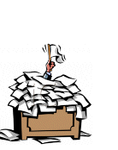

Pricing
Branded: Pharmaceutical Pricing Reimbursement Scheme
  Voluntary agreement between Ministry and company, backed by statutory powers
Generics: category M

Slide 16

The PPRS is the UK’s current pricing system for branded medicines
Since 1957, the prices of branded medicines have been regulated through the Pharmaceutical Price Regulation Scheme
The PPRS is a (non-contractual) voluntary scheme negotiated between the Department of Health and the UK branded pharmaceutical industry, represented by the Association of the British Pharmaceutical Industry (ABPI).
PPRS agreements normally last 5 years. The latest came into force in 2014.
Alongside the voluntary PPRS the Government runs a statutory scheme that applies a price cut to any manufacturer or supplier which chooses not to join the voluntary scheme

Slide 17

Calls to reform PPRS…
“We recommend that Government reform the PPRS replacing current profit and price controls with a value based approach to pricing to ensure the price of drugs reflect their clinical and therapeutic value to patients and the broader NHS.”
OFT, February 2007
Notes:
“The OFT is responsible for making markets work well for consumers. We achieve this by promoting and protecting consumer interests throughout the UK, while ensuring that businesses are fair and competitive.”

Slide 18

Proposals from 2010-2014 for “Value based pricing” and multiple thresholds (1)
“We will pay drug companies according to the value of new medicines…”
The Coalition: our programme for government, July 2010
“…the Government would set a range of thresholds or maximum prices reflecting the different values that medicines offer…”
Price premium for disease severity, therapeutic innovation and wider societal benefits
Consultation document on VBP, Dec 2010

Slide 19
Proposals from 2010-2014 for “Value based pricing” and multiple thresholds (2)
March 2013:
Government confirmed that “NICE will be responsible for the full value assessment of medicines under the future system.”
March-June 2014:
Based on DH Terms of Reference, NICE went to consultation on a possible approach to what is now known as ‘value based assessment’.
Following a wide and inconclusive consultation, the working group at NICE decided to recommend to the NICE Board that “no changes to the technology appraisal methodology should be made in the short term”. The NICE Board agreed.
Notes:
DH TOR:
The methods for value assessment of branded medicines under Value-Based Pricing should:
- be applied to medicines within the scope of the Value-Based Pricing system, and incorporated into the methods for other categories of guidance at NICE’s discretion;
- adopt the same benefit perspective for all technologies falling within the scope of VBP, and for displaced treatments(1);
- be as transparent and predictable as possible;
- be informed by the best available evidence;
- include a simple system of weighting for burden of illness that appropriately reflects the differential value of treatments for the most serious conditions(2);
- encompass the differential valuation of ‘End of Life’ treatments in the current approach within the system of Burden of Illness weights;
include a proportionate system for taking account of Wider Societal Benefits(3);
not include a further weighting for Therapeutic Innovation and Improvement(4);
produce guidance for patients and the NHS which describes the clinical and cost effectiveness of the technology and its position in clinical practice.
Notes
1. That is, the value of a new treatment is considered net of the value of what is displaced, and the valuation methodology is applied consistently across treatments, including where the
net value impact in respect of an element of VBP may be negative
2. For example, using a simple percentage weighting that is proportionate to the QALY loss suffered by patients with the condition
3. The perspective adopted for measuring WSBs should, in principle, be as set out in the HMT Green Book for Appraisal and Evaluation in Central Government - which specifies the cross-
Government approach for evaluating costs and benefits of spending decisions. However in practice it will be important to reflect uncertainties in the evidence for the magnitude of
WSBs, the novelty of the approach, and the degree of consensus among stakeholders. Options may in practice include constraining the weight given to different elements of WSBs
in the valuation of treatments, or initially taking a selective approach to the types of benefit included in the assessment framework, in order to support incremental broadening of the
value perspective. It will be important to ensure that the approach to incorporating WSB is applied systematically and consistently.
4. To ensure that innovation is rewarded only when the technology’s use brings extra value.
Department of Health – June 2013

Slide 20
2014 PPRS
NICE will not negotiate, publicly set or publicly indicate prices
(Department of Health does not intend to set an acceptable price or, after a NICE appraisal, formally state that a particular price has been accepted)
“New medicines launched in the UK market….It is assumed that prices at launch will be set at a level that is close to their expected value as assessed by NICE.”
The ToR for value based assessment will not prevent NICE Appraisal Committees from applying deliberation in the assessment process as they do now. The outcome of a NICE technology appraisal and the form in which it will appear will therefore be largely unchanged.
Notes:
NICE board meeting September 2014 following consultation on VBA:
No changes to the technology appraisal methodology should be made in the short term. EOL protocol to be retained unchanged

Slide 21
Reflecting Value in the PPRS: Flexible Pricing and Patient Access Schemes
Flexible Pricing – where a scheme member can apply for an increase or decrease to a product’s original list price in light of new evidence or a different indication being developed.
Patient Access Schemes – which can facilitate patient access to a medicine where NICE’s assessment of value, on the current evidence base, is unlikely to support the list price.

Slide 22
Flexible Pricing
A company can increase or decrease its original list price in light of new evidence or a new indication being developed.
Exclusively subject to NICE approval
Only once for each drug and no more than 30% of original price
NICE does not negotiate or set prices for medical technologies in the UK

Slide 23
Key principles of PAS
Full costs of scheme implementation included in the NICE appraisal - NICE PAS Unit
Clinically robust, clinically plausible, appropriate, monitorable (reliable markers), operationally manageable, clear stopping rules, consistent with NHS financial flows, broad NHS consultation
Companies encouraged to apply at an early stage of the appraisal (not after rejection)
Only one PAS for each drug
Notes:
payers must be able to calculate the effective price for their patient population, so the costs and savings accrue to those local services making commissioning and treatment decisions

Slide 24
Examples of PAS in NICE guidance (1)
TA | Treatment | Indication | Type of PAS
TA129 | Bortezomib (Velcade) | Multiple myeloma | Response-rebate
TA155 | Ranibizumab (Lucentis) | Macular degeneration (Acute wet AMD) | Dose-capping
TA162 | Erlotinib (Tarceva) | Non small cell lung cancer | Cost equalisation
TA169 | Sunitinib (Sutent) | Renal cell carcinoma | First cycle free
TA171 | Lenalidomide (Revlimid) | Multiple myeloma | Dose-capping
TA176 | Cetuximab (Erbitux) | Metastatic colorectal cancer (first Line) | Discount
TA179 | Sunitinib (Sutent) | Gastrointestinal stromal tumour | First cycle free
TA180 | Ustekinumab (Stelera) | Moderate to severe psoriasis | Weight equalisation
TA185 | Trabectedin (Yondelis) | Advanced soft tissue sarcoma | Cost after fifth cycle met by manufacturer
TA186 | Certolizumab pegol (Cimzia) | Rheumatoid arthritis | First 12 weeks free of charge
TA192 | Gefitinib (Iressa) | Non small cell lung cancer | Fixed cost per patient
TA215 | Pazopanib (Votrient) | Advanced renal cell carcinoma | Discount
TA218 | Azacitidine (Vidaza) | Myelodysplastic syndromes, CML, AML | Discount
TA220 | Golimumab (Simponi) | Psoriatic arthritis | 100 mg = 50 mg
TA238 | Tocilizumab (RoActemra) | Systemic juvenile idiopathic arthritis | Discount
TA241 | Nilotinib (Tasigna) | Imatinib-resistant chronic myeloid leukaemia | Discount
TA251 | Nilotinib (Tasigna) | First-line treatment of chronic myeloid leukaemia | Discount
TA254 | Fingolimod (Gilenya) | Highly active relapsing-remitting multiple sclerosis | Discount
TA258 | Erlotinib (Tarceva) | Non-small-cell lung cancer | Discount
TA259 | Abiraterone acetate (Zytiga) | Castration-resistant metastatic prostate cancer | Discount
TA265 | Denosumab (Xgeva) | Skeletal related events in adults with bone metastases from solid tumours | Discount
TA268 | Ipilimumab (Yervoy) | Advanced melanoma, 2nd Line | Discount
TA269 | Vemurafenib (Zelboraf) | Metastatic mutation positive melanoma | Discount
2007
2009
2011
2012

Slide 25
Examples of PAS in NICE guidance (2)
TA | Treatment | Indication | Type of PAS
TA274 | Ranibizumab (Lucentis) | Diabetic macular odema | Discount
TA276 | Colistimethate (Colobreathe) | Pseudomonas aeruginosa for adults and children over 6 with cystic fibrosis | Discount
TA276 | Tobramycin (TOBI Podhaler) | Pseudomonas aeruginosa for adults and children over 6 with cystic fibrosis | Discount
TA278 | Omalizumab (Xolair) | Severe persistant asthma | Discount
TA280 | Abatacept (Orencia) | Rheumatoid arthritis, polyarticular juvenile idiopathic arthritis | Discount
TA282 | Pirfenidone (Esbriet) | Mild to moderate idiopathic pulmonary fibrosis | Discount
TA283 | Ranibizumab (Lucentis) | Macular oedema secondary to retinal vein occlusion | Discount
TA293 | Eltrombopag (Revolade) | Chronic immune (idiopathic) thrombocytopenic purpura | Discount
TA294 | Aflibercept (Eylea) | Wet age‑related macular degeneration | Discount
TA298 | Ranibizumab (Lucentis) | Choroidal neovascularisation secondary to pathologic myopia | Discount
TA301 | Fluocinolone (Iluvien) | Diabetic macula oedema | Discount
TA303 | Teriflunomide (Aubagio) | Active relapsing-remitting multiple sclerosis | Discount
TA305 | Aflibercept (Eylea) | Visual impairment caused by macular oedema secondary to central retinal vein occlusion | Discount
TA306 | Pixantrone (Pixuvri) | Multiple relapsed or refractory aggressive non-Hodgkin's B-cell lymphoma | Discount
TA310 | Afatinib (Giotrif) | Locally advanced or metastatic non-small cell lung cancer (NSCLC) with activating epidermal growth factor receptor (EGFR) | Discount
TA316 | Enzalutamide (Xtandi) | Metastatic hormone‑relapsed prostate cancer in adults… | Discount
TA319 | Ipilimumab (Yervoy) | Adults with previously untreated advanced (unresectable/metastatic) melanoma | Discount
TA320 | Dimethyl fumarate (Tecfidera) | Adults with active relapsing‑remitting multiple sclerosis | Discount
2012
2013
2014

Slide 26
Controversies and challenges…

Slide 27

Cancer Drugs Fund (1)
“We will create a Cancer Drugs Fund to enable patients to access the cancer drugs their doctors think will help them, paid for using money saved by the NHS through our pledge to stop the rise in Employer National Insurance contributions from April 2011.”
HM Government, 20 May 2010
Notes:
Daily Mail: “Almost £200million was allocated to the Cancer Drugs Fund during the financial year April 2011 to March 2012, yet figures suggest in some areas less than one third of the money has been spent.”
Eric Low, chief executive of advocacy group Myeloma UK: “scheme sends a signal to industry that the NHS will pay for or reward mediocrity”

Slide 28
Cancer Drugs Fund (2)
Since 2011, the fund has ring-fenced £200 million a year of the NHS budget for cancer treatments which may not yet have been assessed by NICE or which have been found not to be cost or clinically effective enough for wider use on the NHS.
No other condition has a dedicated fund to provide access to drugs not routinely available on the NHS
Intended to run until March 2014 but extended until March 2016 (a total lifetime budget of £1.27 billion)
On 1 April 2013, NHS England took on responsibility for the operational management of the CDF.
Notes:
NHS organisations have always been able to consider exceptions to our guidance. The Cancer Drugs Fund provides a national resource to meet the cost of those exceptions.

Slide 29
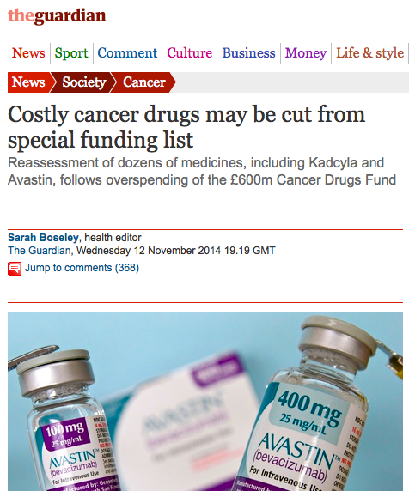
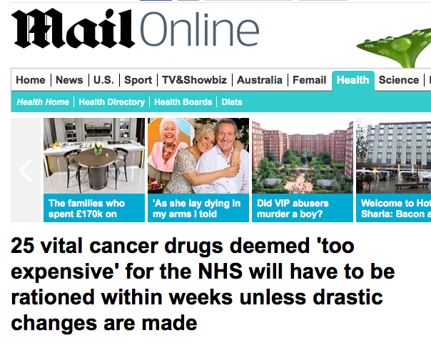
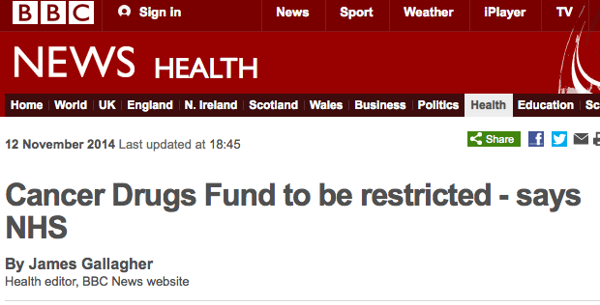
Reinventing NICE?

Slide 30
Cancer Drugs Fund (3)
National Audit Office (2015)
  “All parties agree that the Fund is not sustainable in its current form.”
NHS England and NICE recently consulted on plans to reform the Cancer Drugs Fund (CDF).
  The proposal is that the CDF will become a ‘managed access’ fund for new cancer drugs to give early access to those drugs which appear promising but which have currently uncertain evidence bases which are insufficient to support a recommendation for routine commissioning.
  Initial NICE appraisal and if recommended for use in CDF “real world” evidence collected for up to two years – then drug re-appraised by NICE
Notes:
It is proposed that all new cancer drugs will be referred to NICE for appraisal. The outcome of each initial NICE appraisal will be a recommendation falling into one of the following three categories:
• recommended for routine use
• not recommended for routine use
• recommended for use within the CDF.
The new CDF recommendation will enable patients to receive new treatments that can't yet be recommended for routine use but which have "genuine promise", while real world evidence is collected for up to 2 years on how well the drugs work in practice.
At the end of the period for use within the CDF, the drug will go through a short NICE appraisal, using the additional evidence. The drug will then attract either a NICE positive recommendation, at which point it would move out of the CDF into routine commissioning. Alternatively, it will receive a NICE negative recommendation, meaning it would move out of the CDF and become available only on the basis of individual patient funding requests.
The new scheme would operate from April 2016.

Slide 31
Looking beyond the assessment of individual “technologies” – clinical guidelines, pathways and quality

Slide 32
Clinical guidelines - what are they?
Broad guidance covering all or specific aspects of the management of a particular condition (the pathway) [up to 24 months]
Incorporates technology appraisals, interventional procedures and other related NICE guidance where appropriate
Recommendations advisory only (but can be used to develop quality standards to assess clinical practice and inform payment )
Notes:
Development of a new “full” guideline takes approximately 24 months. Updates usually take less time.
Broad guidance covering all or specific aspects of the management of a particular condition (the pathway). Incorporates technology appraisals and interventional procedures when relevant
Recommendations advisory only.
How NICE supports effective clinical practice
NICE sets the standards for high quality care in the NHS.
It is the job of NHS primary care trusts and hospitals to provide high-quality healthcare at local levels. Clinical governance (a framework within which NHS organisations are accountable for continually improving standards of care) helps them to manage and monitor the quality of care they provide. Clinical governance is backed up by health professionals’ self-regulation and their continuing professional training.

Slide 33
NICE Pathways

Slide 34
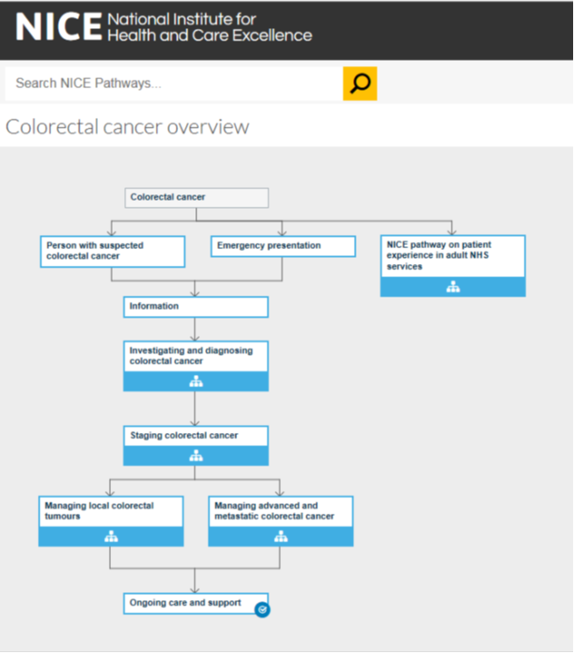

NICE Pathways

Slide 35
Developing guidelines – some challenges….
Scope
  What to include/exclude?
Timeliness
Taking into account cost-effectiveness
  Selecting topics for de novo modelling
  When to rely on published data
  When to apply informal approaches (e.g. a “balance sheet” approach)
  Keeping guidelines up to date

Slide 36
From evidence to setting standards and improving quality
Clinical Trials and Evidence Reviews
Clinical Guidelines and Health Technology Assessment
“Quality Standards”
Medical education and professional training
Performance management
Budget management
Provider payment mechanisms incl. case-based payment
Communication of entitlement to patients and their families
Clinical audit and provider benchmarking
Provider regulation and accreditation

Slide 37
What are quality standards?
Quality standards are a concise set of evidence-informed statements, designed to drive and measure priority quality improvements, within a particular area of care (e.g. acute management of stroke).

Slide 38
Quality and the Health and Social Care Act 2012
Care Act 2012:
NICE’s Quality Standards
“The Secretary of State must…secure continuous improvement in the quality of services provided to individuals…In discharging the duty…the Secretary of State must have regard to the quality standards prepared by NICE under section 234 of the Health and Social Care Act 2012.”

Slide 39
Quality Standards aim to improve quality and reduce variation
Markers of high quality care (not minimum standards!) in terms of: clinical effectiveness, safety, and patient experience
Focus on areas where sub-optimal clinical practice is common
Derived from best available evidence, e.g. WHO, NICE, other local guidance
Aligned with government/payer priorities
Produced collaboratively with stakeholders (policymakers, payers, hospital managers, clinicians, service users, professional/patient organisations).

Slide 40
Quality Standards do not:
Review or re-assess the underlying evidence base
List all necessary components of acceptable care

Slide 41

QS are an evolutionary process which drives improvement
Evidence
The starting point is the evidence base (clinical trials etc.)
Evidence is distilled to produce clinical guidelines
Quality standards are derived from evidence-based clinical guidelines
QS indicators and measures can inform quality initiatives and financial incentives.
Clinical guidelines
Quality standards
Quality measures
Incentives
NICE copyright © 2013
Notes:
Payers
Payment mechanisms (incl. case-based payment)
Providers
Benchmarking
Clinical audit
Regulation and accreditation
Clinicians
Professional education and training
Performance management
Patients and families
Communication of entitlement
Improved outcomes

Slide 42
Example: Colorectal Cancer Quality Standard (QS20)
Quality statement 1
People with suspected colorectal cancer without major comorbidity are offered diagnostic colonoscopy
Quality measure
Structure: Evidence of local arrangements to ensure people with suspected colorectal cancer without major comorbidity are offered diagnostic colonoscopy.
Process: Proportion of people with suspected colorectal cancer without major comorbidity who receive diagnostic colonoscopy.
Numerator – the number of people in the denominator who receive diagnostic colonoscopy.
Denominator – the number of people with suspected colorectal cancer without major comorbidity.

Slide 43



Incentives and indicators: the “Quality and Outcomes Framework”
The quality and outcomes (QOF) framework came into effect in 2004 as part of the new GP contract
QOF is a voluntary programme for all GP surgeries. It is designed to resource and reward good practice in all GP surgeries
QOF originally accounted for up to 20-25% of average practice income after introduction (now closer to 10%)
QOF consists of 3 domains: clinical; public health; and additional public health services (e.g. cervical screening)
Clinical is the largest domain in terms of number of indicators and achievable points

Slide 44
In 2009, Ministers ask NICE to:
Develop new and review/retire existing indicators
Focus on health outcomes and underpinning evidence base, including burden of disease
Ensure indicator activity and accompanying monetary incentive are cost-effective
Offer procedurally fair, transparent and effective engagement platform for key stakeholders
Ensure GP practices and local NHS have greater flexibility to select quality indicators (from a national menu)
Reduce number of organisational and process indicators to target more resources on health outcomes and quality improvement
Rationale:
Improve evidence base for indicators which had been introduced quickly (using expert panel Delphi procedures, but with limited transparency)
Independent means to retire ineffective indicators
NICE Advisory Committee: effective engagement of key stakeholders

Slide 45
The NICE criteria for selecting indicators (2015) – multiple settings
Indicators now developed for use in different settings including QOF.
In considering if it is appropriate for NICE to develop an indicator on the topic, the Indicator Advisory Committee is asked to consider the following:
Is the proposed indicator an outcome or a process linked by evidence to improved outcomes?
Does the proposed indicator meet a national priority area?
Is it feasible to measure the proposed indicator?
Will the proposed indicator support quality improvement?
Is the proposed indicator attributable to the audience of the indicator set?
Notes:
In considering if it is appropriate for NICE to develop an indicator on the topic, the Indicator Advisory Committee is asked to consider the following: 1. Is the proposed indicator an outcome or a process linked by evidence to improved outcomes? a) Is the indicator measuring an outcome that reflects the quality of care? (Ideally, but not always, related to a NICE quality standard.) b) If the indicator is measuring a process is it linked by evidence to improved outcomes and supported by a NICE quality standard, NICE guidance or NICE accredited guidance? 2. Does the proposed indicator meet a national priority area? a) To what extent does it support improvements in the national outcomes frameworks for the NHS, public health or adult social care? b) Does it reflect a specific priority area identified by NHS England, Public Health England and/or the devolved administrations in Northern Ireland, Wales and Scotland? 3. Is it feasible to measure the proposed indicator? a) Is there a data collection and data fields to support the indicator or can these be developed? b) Can the indicator be developed so that it is measurable in a meaningful manner through available information systems? 4. Will the proposed indicator support quality improvement? a) Does it relate to an area where there is variation in practice? Indicators process guide 32 of 32 b) Is it an area where adoption of best practice could improve quality in terms of the impact on outcomes (effectiveness, experience or safety) for the population? 5. Is the proposed indicator attributable to the audience of the indicator set? a) Is it, at least in part, attributable to actions of general practice? b) Is it, at least in part, attributable to the actions of commissioners for a local health community?

Slide 46
Key lessons from UK QOF
Create infrastructure and measure baseline performance
Use technical support and robust/transparent process
Involve physicians
  Value of testing & piloting
  Send feedback after they send you data
Start with a small number of indicators
Decide a model for setting monetary value of the QOF (not just indicators: who determines points & value?)
  Make payments large enough to be meaningful, small enough not to distort priorities
Re-calibrate incentives to remain challenging but attainable
Think about (and budget for) audit – selective? random?
Monitor patient outcomes & unintended consequences
Acknowledgment: Tim Doran

Slide 47
Lessons from the ‘NICE way’
Good governance structures can significantly increase the legitimacy (in the eyes of the law and of the public) of priority setting decisions, but:
The process needs a degree of flexibility to avoid being too rigid
The system needs to be responsive and be able to adapt to changing needs
Importance of reviewing processes/methods
An inclusive, multidisciplinary approach can improve both the quality and legitimacy of decisions made
Notes:
What are some of the lessons that can be taken away from this experience.
Good governance structures can significantly increase the legitimacy (in the eyes of the law and of the public) of HTA decisions, but:
The process needs a degree of flexibility to avoid being too rigid
The system needs to be responsive and be able to adapt to changing needs
Importance of reviewing and updating processes/methods
A more general lesson around – government support/ backing –
Story about one of the first TA published and Glaxo CEO demanding Tony Blair overturn the decision and get rid of NICE.
Tony Blair said that NICE was doing a good job and that NICE was independent and the government wouldn’t interfere with the decision.

Slide 48

“Any new NICE-type institution aiming to be an evidence intermediary must avoid only working in a navel-gazing technocratic, academic research-focused silo. There is a need to engage with wider audiences, and the difficult and messy politics that goes with making tough decisions relating to crime, education and other areas of social policy.”

Slide 49
Going global…..the International Decision Support Initiative (iDSI)
iDSI is a global network of public bodies, think-tanks, and academics in priority-setting, and comprises core partners: NICE International (UK), HITAP (Health Interventions and Technology Assessment Program, Thailand), CGD (Center for Global Development, USA), and PRICELESS SA (Priority Cost Effective Lessons for System Strengthening at the University of Witwatersrand School of Public Health, South Africa), who join as the iDSI regional hub for sub-Saharan Africa.
http://www.idsihealth.org/
Notes:
In the era of Sustainable Development Goals and countries transitioning from aid, country policymakers will increasingly be making their own healthcare spending decisions with the goal of UHC. iDSI will provide much needed support for countries, and respond to growing demand for knowledge sharing and capacity building for priority-setting.

Slide 50







Better Decisions for Better Health
Evidence-informed, transparent, independent, consultative decision making processes
Demand-driven support
Policy-informed knowledge products
Better Health
Effective
do-er partnerships
Stronger
country institutions
Better decisions
Accountable institutions and processes protect politicians from vested interests and help defend tough choices
Practical support and knowledge products
More efficient and equitable resource allocation decisions with trade-offs made explicit
There is a complex translation process between “better decisions” and “better health” depending on the link between decisions and budgets, budgets and payments/transfers, transfers and delivery system, readiness and effectiveness of delivery and implementation and also the validity and reliability of the original data informing the analysis.
Notes:
iDSI’s mission is to guide decision makers to effective, efficient and ethical healthcare resource allocation strategies for improving people’s health. Since 2014 it has significantly strengthened local capacities for setting health priorities across Indonesia, India, Vietnam, China and South Africa.

Slide 51


Notes:
Just very quickly on NICE International.

